Slide 1

OCSA SENIOR INFORMATION NIGHT
PRESENTED BY: school COUNSELING DEPARTMENT
MR. ARRINGTON, Ms. Karaki, & mrS. gILL

Slide 2

MEET YOUR COUNSELORS
Mr. Arrington: Band, Orchestra, Vocal
Ms.Karaki: Creative Writing, Technical Theatre, Dance, Drama,Visual Arts
Ms. Gill: College and Career Counselor
Ms. Tattoli: Valencia College Transition Coach

Slide 3

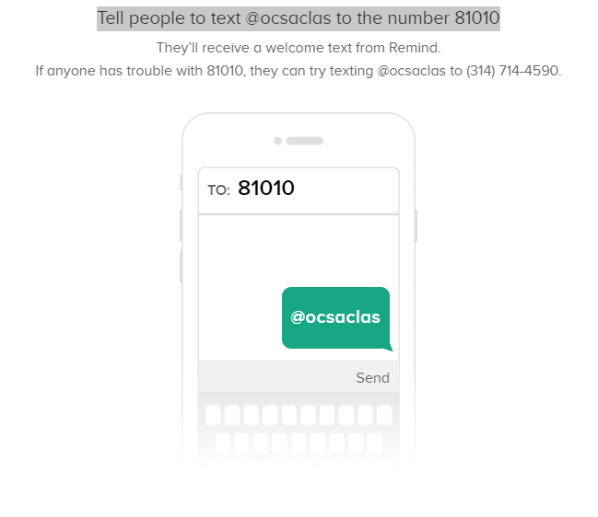
How do I sign up for information for my Senior?

Slide 4
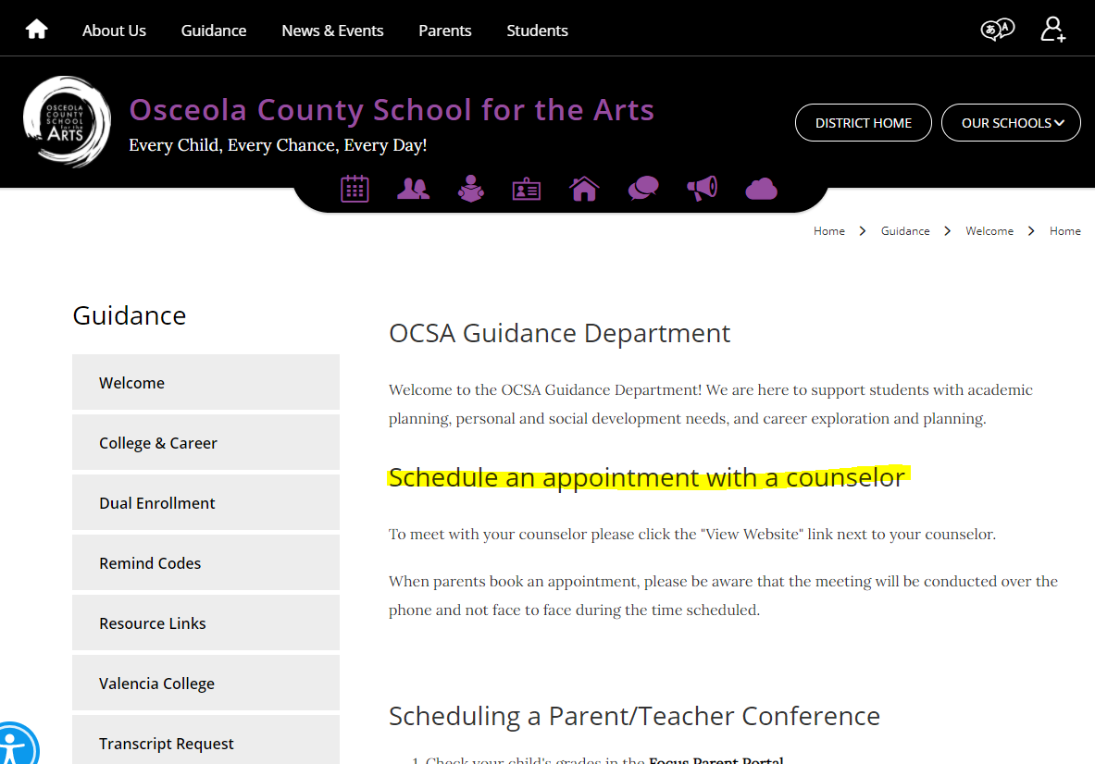
How do I make an appointment with the counselor?

Slide 5
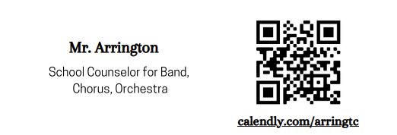
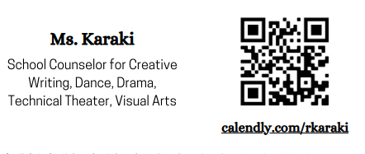

Schedule an appointment with your School Counselor
Mr. Arrington
Ms. Karaki
Ms. Gill

Slide 6

What does it take to get accepted?
Holistic Review
Rigor/GPA
ACT/SAT Scores
Extracurricular activities
Recommendations
Application Essays

Slide 7
Rigor/GPA
Rigor of Courses:
Exceed number of required Core courses
(Math, Science, English, Social Studies, Foreign Languages)
Challenge yourself with Honors & Dual Enrollment classes
Strong schedule Senior year can result in acceptance and success
GPA
Grades are a key factor however so is rigor
Steady performance over time, particularly junior year.
Continue to work on your GPA until the end.

Slide 8
Extracurricular activities
Colleges look for students who will contribute to their campus both inside and outside the classroom, as well as their communities.
QUALITY over QUANTITY! Do not attempt to join every club or sport on campus. Pick a few activities and do them well. Be a leader by holding office in a club.
Be well rounded by varying your activities.
Quality volunteer hours through school and/or community organizations are also looked at favorably for both admissions and scholarships.

Slide 9
Recommendations
Many colleges require recommendation letters to help them give insight into a student's potential. They are part of the humanizing piece and can help tip the scale in either direction.
Ask teachers who know you well and provide them with a resume of your activities and involvement to help the letter be more specific and beneficial.
If applying to a college on the Common Application, it will require recommendation from a counselor and perhaps 2 other letters.
If the recommendation is optional, DO IT!
Give your teachers and counselors plenty of notice! If you do not provide a resume to your counselor, they cannot write a letter.

Slide 10
Essays
Many colleges use essays to learn about you. Another humanizing piece of your application.
It needs to be carefully constructed, interesting, informative and clever so you will stand out. Be original!
If an essay is optional, do it! Pay attention to punctuation, spelling, grammar and word choice.
Proofread, proofread, proofread and also ask someone else to proofread such as an English teacher.
Remember you never get a second chance to make a first impression with your essay.

Slide 11
ACT/SAT Scores
Required, weighed equally and super scored by MOST colleges.
The more competitive the college, the more important the score
Compare students nationwide and predict success
Used for scholarships and select programs
Prospective college students should take EACH TEST AT LEAST once during junior year, preferably twice, and possibly one more time early in Senior year.
Khanacademy.org is free SAT practice we use in the District
Oct 13th: SAT for Seniors (in school)
Prepare for the tests...DO NOT take them cold turkey!

Slide 12
How do I register for tests?
Register online prior to deadline to avoid late fees and alternative test sites
ACT: actstudent.org SAT: collegeboard.org
Practice SAT: Khanacademy.org
ACT: academy.act.org
Send scores to colleges and universities. You may send up to 4 free at the time of testing, after that it costs $$. Most schools super score so it is best to send them each time.
Keep all test information and passwords in a safe place.

Slide 13
What is a fee waiver and how do I qualify?
Juniors and Seniors who qualify for free/reduced lunch may receive 2 test fee waivers for Sat and 4 for ACT.
Seniors who qualify for the waivers may also get 4 College Application fee waivers in their College Board account.
Waivers are issued by Ms. Gill in the College and Career Center in the Media Center.

Slide 14
Post-secondary options
Four year colleges and universities: both public and private
Grant bachelor's degrees either BA or BS
Geared toward professional occupations
Two year college grants Associates degrees: AA or AS
Offers many technical programs and certificates
Specializes in transferring to 4 year colleges
Vocational/trade schools
Grants industry certifications/certificates

Slide 15
Post secondary options
Military
Employment

Slide 16
Factors to consider for choosing the right school
Entrance requirements: Middle 50th percentile
Size of school: Small Mid size ,or large
Major area of study
Location: Climate/Distance/Transportation
Urban vs rural
Accreditation: Regional credits transfer
Athletic programs
Cost: How much can you afford to pay? Have the conversation NOW!

Slide 17
Steps to the College application process
Get organized/prioritize deadlines
Complete applications
  Letter of recommendations
  Review essays
  Submit and pay application fee (fee waiver if applicable)
Request transcripts from Counselors via Xello
Send test scores
Sit back and wait patiently.
Upload copy of acceptance letters / scholarship letters to your Xello portal :)

Slide 18
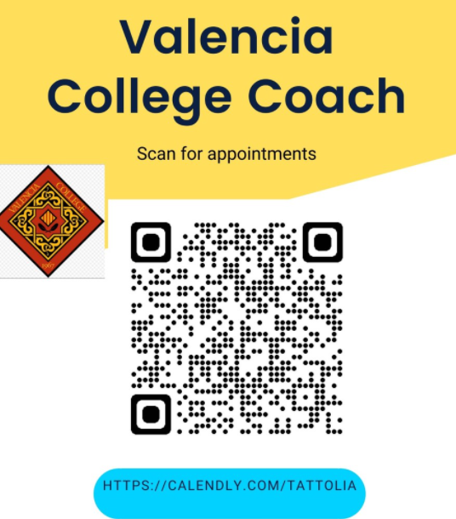
VALENCIA COLLEGE TRANSITION COACH
Ms. Amanda Tattoli
She is available on our REMIND and email.

Slide 19
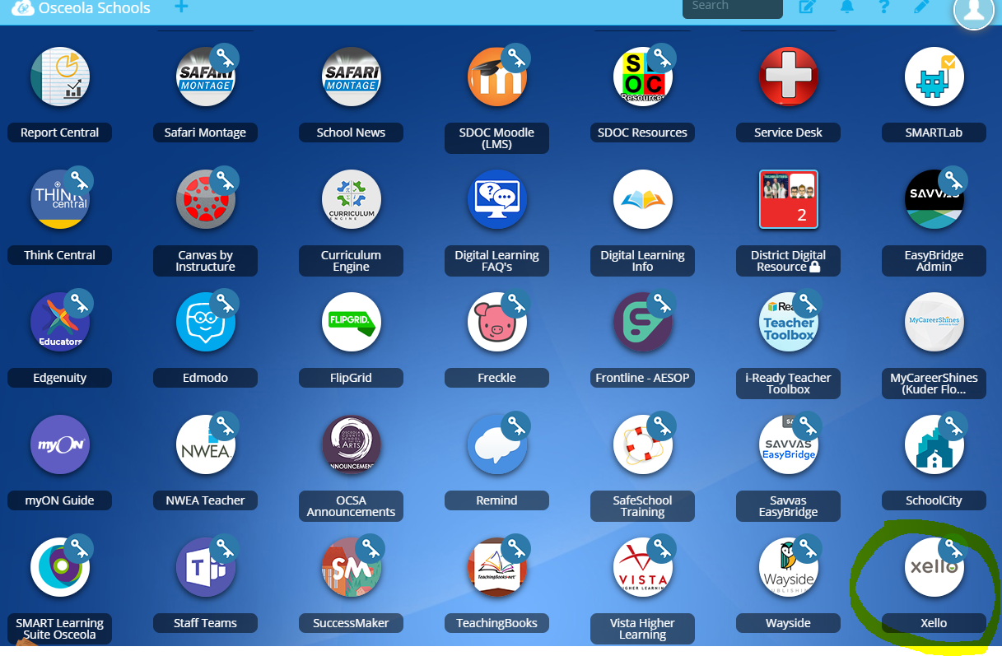
Xello
Xello is a free tool that all Osceola County School for the Arts student have. You can take career assessments, research careers and colleges, use it for goal setting, upload and save documents and so much more!

Slide 20
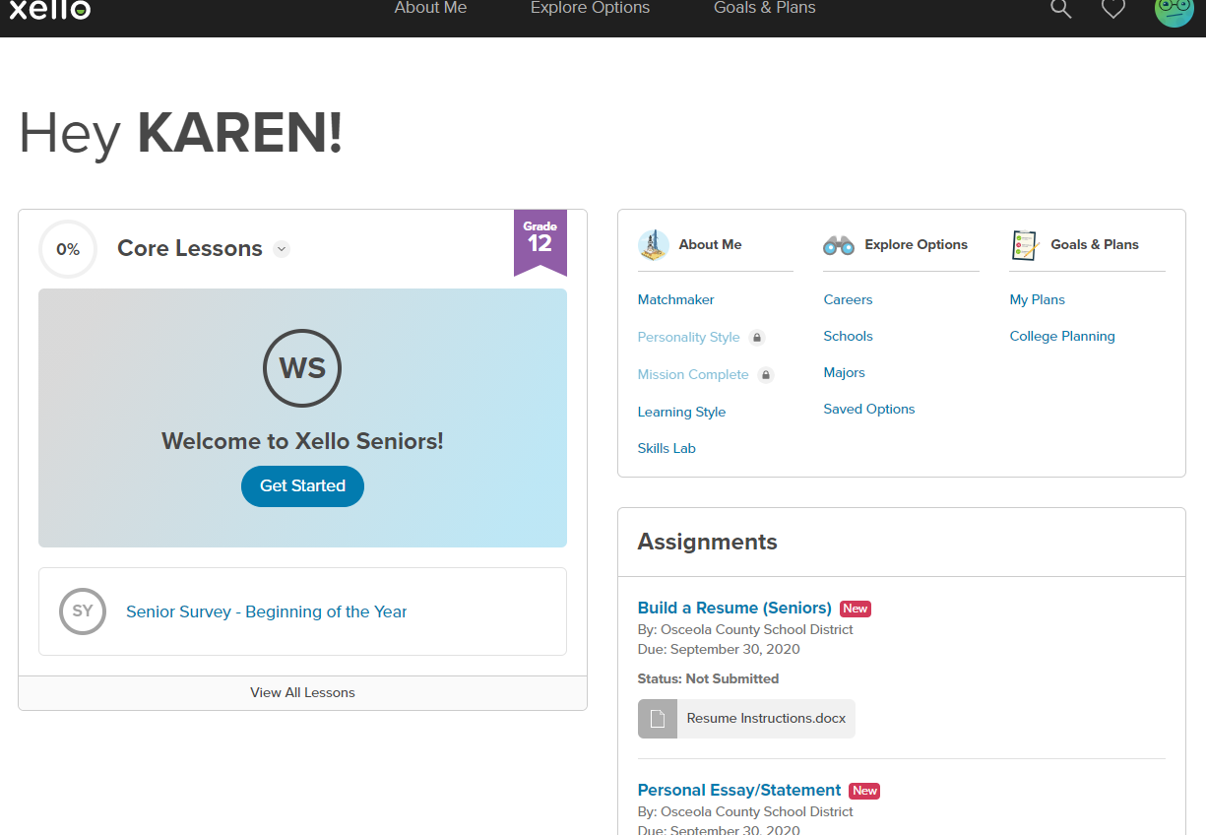
Xello Dashboard
Students can access
  Lessons
  List colleges applying to
  Request transcripts
  Explore careers, schools, majors
  Assignments

Slide 21
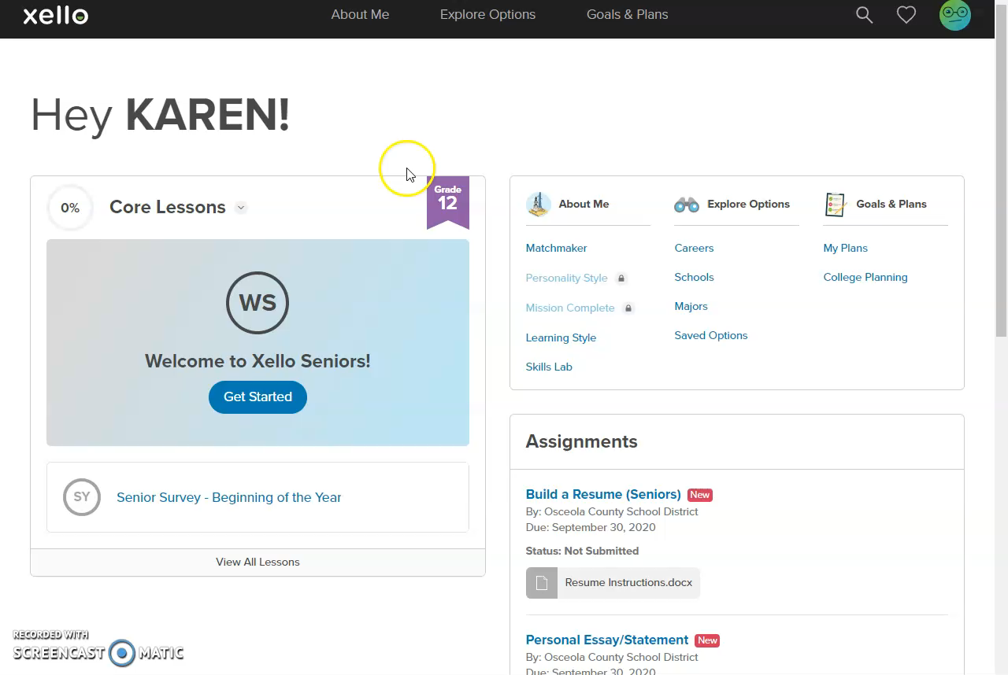
Xello

Slide 22
Sources of Money for College
Ms. Gill-College and Career Counselor

Slide 23

FIRST source of money
FAFSA.gov
  Even if you are not sure if you are going to college or where you are going,
  PLEASE,PLEASE,PLEASE fill this out! Some scholarships require this to be done.
  Open OCT 1st
  TEAMS will have a Financial aid channel with all of the information as a reference

Slide 24
Myth: My income is too high, and I will not qualify. Why fill out FAFSA?
Even if you don’t qualify for free grants, you will qualify for low interest federal direct student loans and parent PLUs loans. You cannot borrow these if you don’t fill out a FAFSA.
Some institutional scholarships require that FAFSA be completed as part of the application process to be considered.
The 22/23 FAFSA will be based on 2020 income. If you had a reduction in income, you could report this directly to the financial aid office at each college and they can re-evaluate the financial aid offer based on the FAFSA on file.

Slide 25

FAFSA ASSISTANCE
We have also partnered up with Educational Partners Inc. to assist with FAFSA completion free of charge. They are an approved federally funded agency.

Slide 26
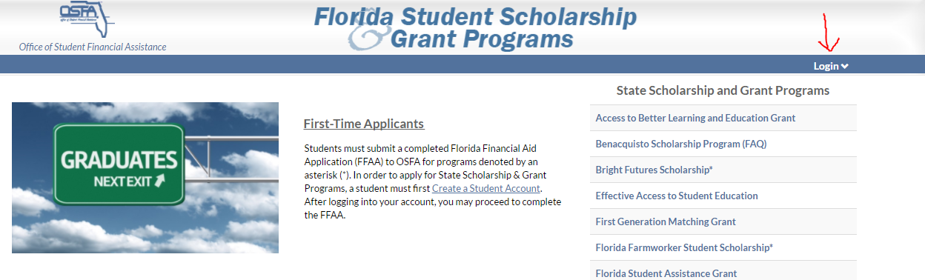
Florida Student Financial Aid
Opens OCT1st
Bright Futures and other grants and scholarships, if you stay in Florida.

Slide 27

Sources of free money

Slide 28

Education Foundation of Osceola www.foundationosceola.org
Access to 85 scholarships !

Slide 29
$$$$$$$$$$$$$$$$$$$$$$
Bright Futures: application opens October 1st and you have until graduation to complete requirements https://www.floridastudentfinancialaidsg.org/SAPHome/SAPHome?url=home
Education Foundation: free scholarships counseling and financial aid workshops November 1st https://www.foundationosceola.org/
FAFSA: Free Application for Federal Student Aid opens October 1st. FAFSA.GOV

Slide 30

College and Career Resources-District

Slide 31
Herff Jones
Mark Satterfield- Herff Jones OCSA representative
To Order, visit www.herfforlando.com
https://drive.google.com/file/d/1-q4-QyLm62eWiEY2AlgPGskM6M24KeHI/view
https://herffjones.wistia.com/medias/2es77m7dpe
https://www.herffjones.com/catalogs/graduationcatalog/
https://www.herffjones.com/catalogs/hs-ringcatalog/

Slide 32

Questions!

